Slide 1
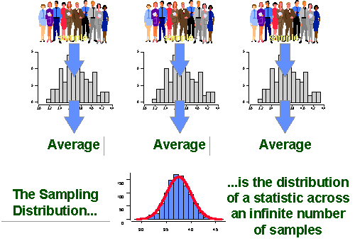
Chapter 7: Sampling Distributions
http://www.socialresearchmethods.net/kb/sampstat.php

Slide 2
6.4: The Exponential Distribution (and Uniform Distribution) - Goals
Be able to recognize situations that may be described by uniform or exponential distributions.
Be able to recognize the sketches of the pdfs for uniform and exponential distribution.
Calculate the probability, mean and standard deviation when X has a uniform or exponential distribution.

Slide 3
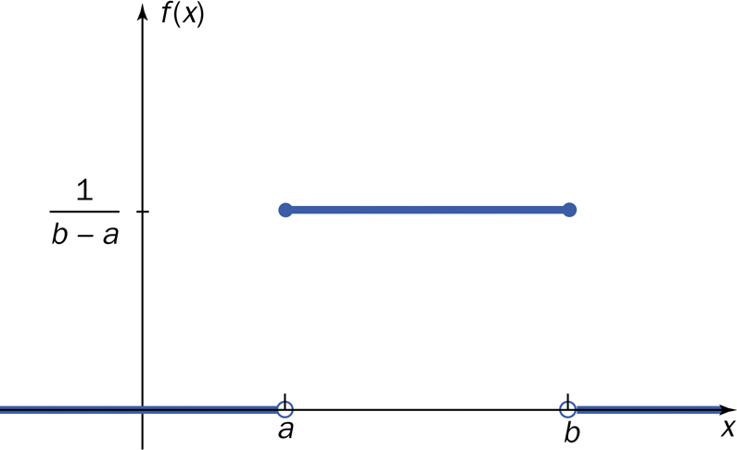
Uniform Distribution
In a (continuous) uniform distribution, the probability density is distributed evenly between two points.

Slide 4
Uniform Distribution
The density function of the uniform distribution over the interval [a,b] is
$$f\left(x\right)=\left\{\begin{matrix}\frac{1}{b−a} & a<x<b \\ 0 & else\end{matrix}\right.$$
$$E\left(X\right)=\frac{a+b}{2}$$
$$σ_{X}=\frac{b−a}{\sqrt{12}}$$

Slide 5
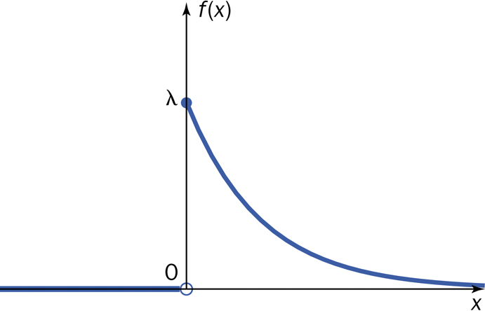
Exponential Distribution
Uses: amount of time until some specific event occurs (the amount of time between successive events)
$f\left(x\right)=\left\{\begin{matrix}λe^{−λx} & x≥0 \\ 0 & else\end{matrix}\right.$

Slide 6
Exponential Distribution
$F\left(x\right)=\left\{\begin{matrix}0 & x<0 \\ 1−e^{−λx} & x≥0\end{matrix}\right.$
$E\left(X\right)=\frac{1}{λ}$
Var$\left(X\right)=\frac{1}{λ^{2}}$
$σ_{X}=\frac{1}{λ}$

Slide 7
Gamma Distribution
Generalization of the exponential function
Uses
probability theory
theoretical statistics
actuarial science
operations research
engineering

Slide 8
Beta Distribution
This distribution is only defined on an interval
standard beta is on the interval [0,1]
uses
modeling proportions
percentages
Probabilities
Uniform distribution is a member of this family.

Slide 9
Other Continuous Random Variables
Weibull
exponential is a member of family
uses: lifetimes
lognormal
log of the normal distribution
uses: products of distributions
Cauchy
symmetrical, long straggly tails

Slide 10
7.1/7.2: Statistics, Parameters, Sampling Distribution of a Sample Mean - Goals
Be able to differentiate between parameters and statistics.
Explain the difference between the sampling distribution of x̄ and the population distribution of μ.
Determine the mean and standard deviation of x̄ for an SRS of size n from a population with mean μ and standard deviation σ.
Use the central limit theorem (CLT) to approximate the shape of the sampling distribution of x̄ and use it to perform probability calculations.

Slide 11
Probability vs. Statistics

Slide 12
Parameter and statistic
A parameter is a numerical descriptive measure of a population.
A statistic is any quantity computed from values in a sample.

Slide 13
Sampling Variability
What would happen if we took many samples?
Population
Sample
Sample
Sample
?
Sample
Sample
Sample
Sample
Sample
A statistic is a random variable.

Slide 14
Sampling Distribution
The sampling distribution of a statistic is the probability distribution of the statistic.

Slide 15
Sampling Distributions
The sampling distribution of a statistic is the distribution of values taken by the statistic in all possible samples of the same size from the same population.
The population distribution of a variable is the distribution of values of the variable among all individuals in the population.

Slide 16
Mean and Standard Deviation
$μ_{\overline{X}}=μ_{X}$
$σ_{\overline{X}}=\frac{σ_{X}}{\sqrt{n}}$

Slide 17
Shape of Sampling Distributions
If a population X ~ N(μ, σ²) then the sample distribution of X̄ ~ N$\left(μ,\frac{σ^{2}}{n}\right)$.
Let X̄ be the mean of observations in a random sample of size n drawn from a population with mean μ and finite variance σ². As the sample size n is large enough, then X̄ $\dot{\sim }$ N$\left(μ,\frac{σ^{2}}{n}\right)$.

Slide 18
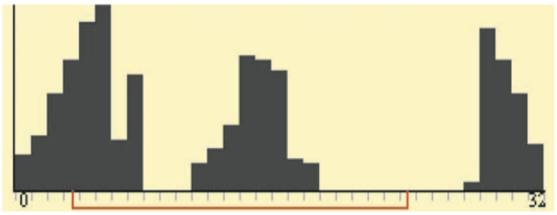
A Few More Facts
Any linear combination of independent Normal random variables is also Normal.
More generally, the distribution of a sum or average of many small random quantities is close to Normal whether independent or not.
CLT also applies to discrete random variables.

